Slide 1

MY CHAT
A Chatting App integrated with
Short video sharing and ChatGPT

Slide 2

PROJECT PRESENTATION FOR MINOR PROJECT - I
MASTER OF COMPUTER APPLICATION
PROJECT GUIDE : SUBMITED BY :
Mrs. Swarnalata Pati Sumit Behera
Assistant Professor 2224100003
CSA (MCA)

Slide 3

CONTENTS
01
02
INTRODUCTION
PROBLEM STATEMENT
03
OBJECTIVE
04
05
06
07
08
09
10
FUNCTIONALITIES
SYSTEM REQUIREMENTS
USECASE DIAGRAM
ACTIVITY FLOW DIAGRAM
FUTURE ENHANCEMENTS
VISUAL APPERANCE OF APP
CONCLUSION

Slide 4
01
INTRODUCTION
In today's digital era, communication and content creation have taken center stage in the realm of mobile applications. Chatting apps have become an essential part of our daily lives, enabling us to connect, share, and engage with others effortlessly. To further enhance the user experience, integrating short videos and advanced conversational AI, such as ChatGPT, into a chatting app opens up a new world of possibilities for dynamic and interactive communication.
Existing Systems :
WhatsApp, Telegram , Instagram

Slide 5
02
PROBLEM STATEMENT
The existing chatting apps often lack the integration of short videos and advanced conversational AI capabilities like ChatGPT, limiting the user's ability to express themselves creatively and engage in lifelike conversations. This creates a gap in the market for a comprehensive chatting app that seamlessly combines short video sharing and the power of ChatGPT

Slide 6
03
OBJECTIVE
The main objective of My chat is to revolutionize traditional chatting apps by incorporating short videos as a core feature. Users can seamlessly capture, share, and view short videos within the app, enhancing the richness and expressiveness of communication. Alongside this, ChatGPT provides an intelligent and interactive conversational experience, ensuring users can engage in meaningful discussions and receive personalized responses.

Slide 7
04
FUNCTIONALITES
Allow users to create accounts securely using email.
Enable users to exchange text messages in real-time, fostering instant communication.
Space optimization by recycleview.
Provide users with the ability to capture and share short videos.
Utilize ChatGPT to generate intelligent and context-aware responses to user Requests.
Revese Engeenering registant , using dexguard.

Slide 8
05
SYSTEM REQUIREMENTS
FRONTEND :
XML
BACKEND :
kotlin
Firebase (Storage, Authenticator, Realtime Database)
ChatGpt API
IDE :
Android Studio
DEVELOPMENT ENVIRONMENT :
Intel i5 8th gen or higher
16 GB RAM
Windows 10 / 11
Android emulator / Physical devide
(API Level 28 or higher)

Slide 9
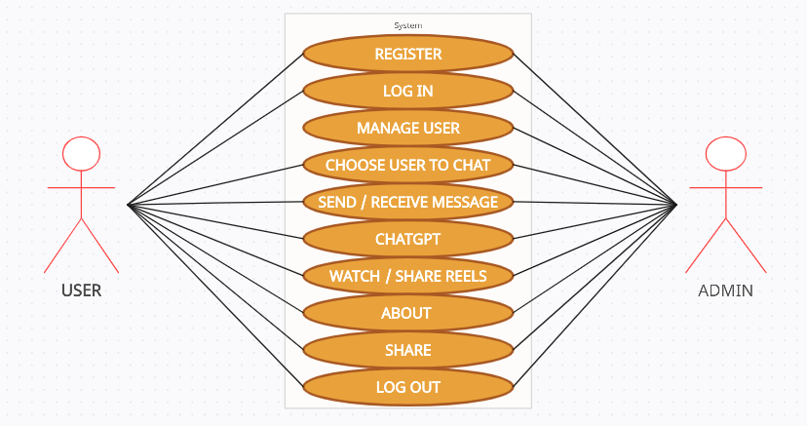
06
USE CASE DIAGRAM

Slide 10
07
ACTIVITY FLOW DIAGRAM
CHAT GPT
ABOUT
SHARE
START
LOG IN
CONTACTS
CHATS
SIGN UP
FEEDS
LOG OUT

Slide 11
08
FUTURE ENHANCEMENTS
KMM (kotlin multiplatform mobile)
Video Call
Voice Call
Last Seen , Online And Typing on navigation bar of chatting activity
Video Upload
Biometric Authentication
Search By contact / user name
End to end encription

Slide 12
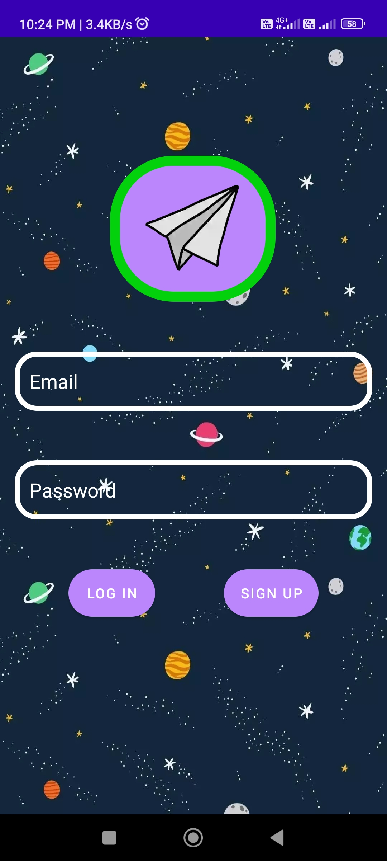
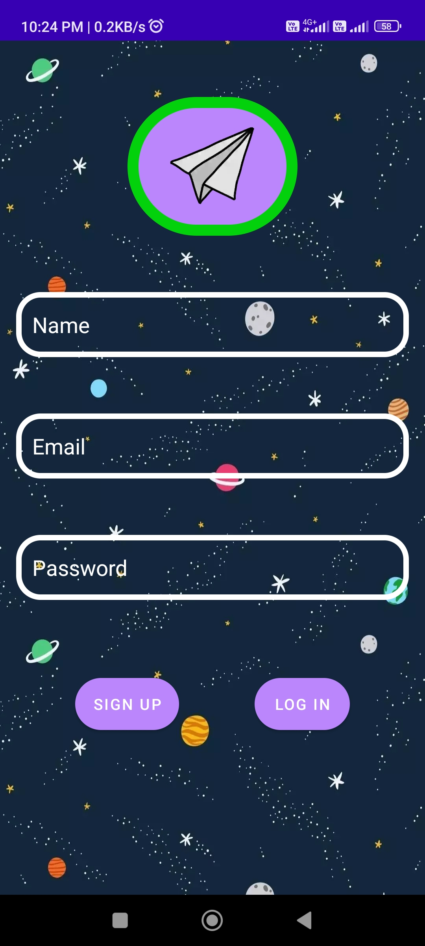
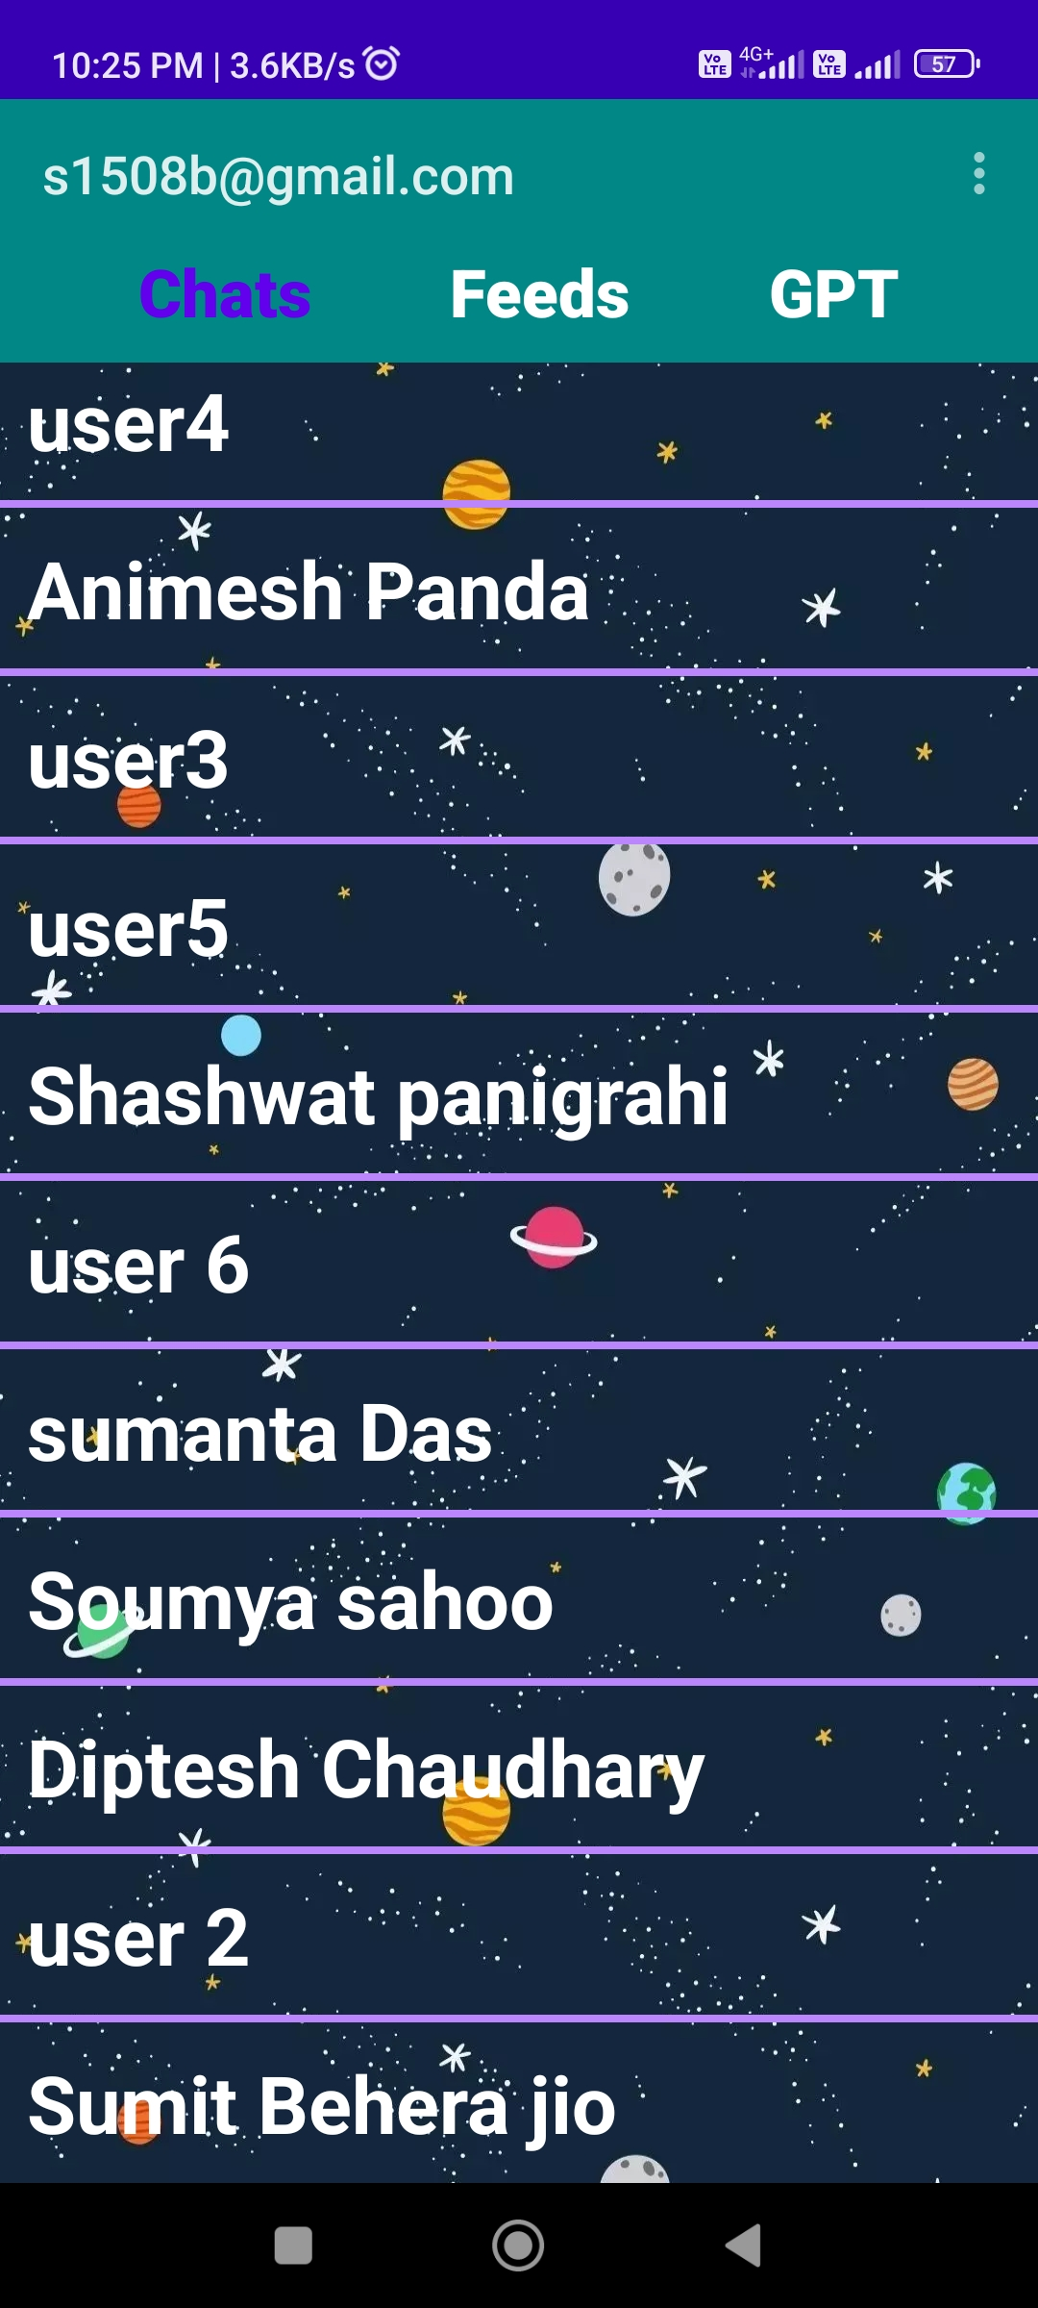
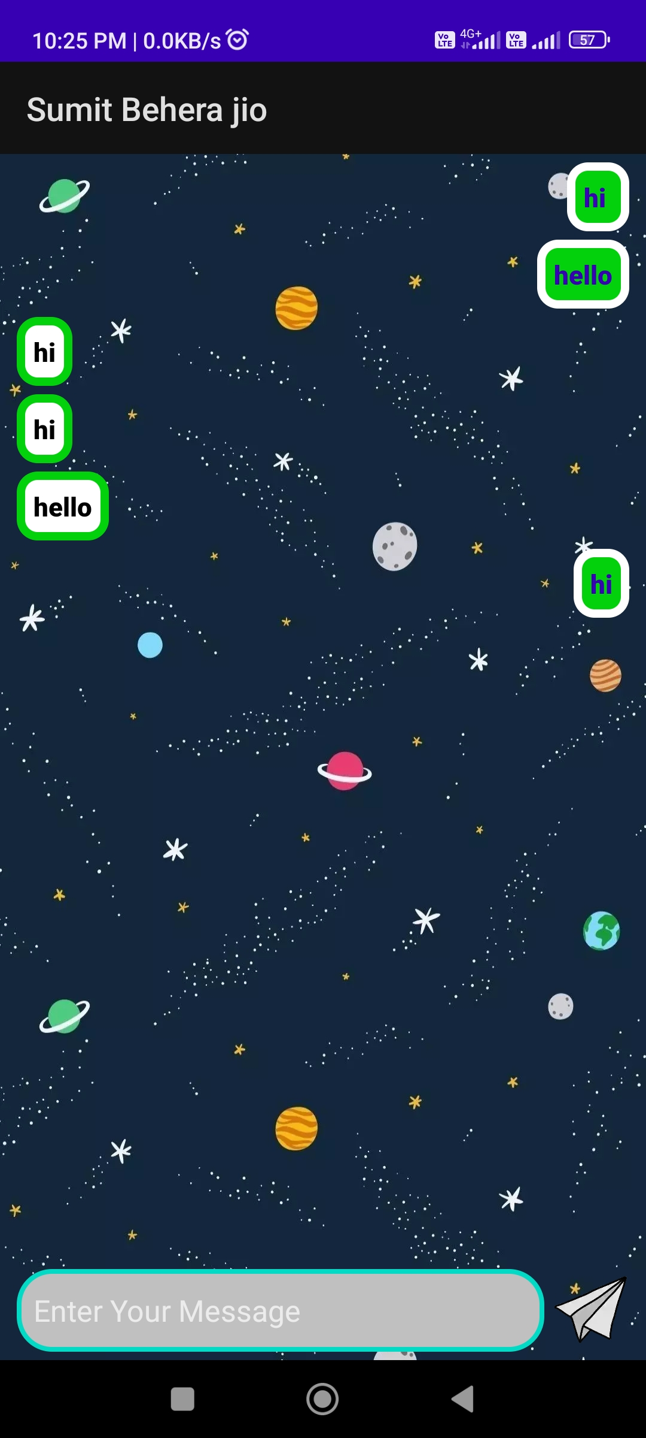
09
VISUAL APPEARANCE OF APP

Slide 13
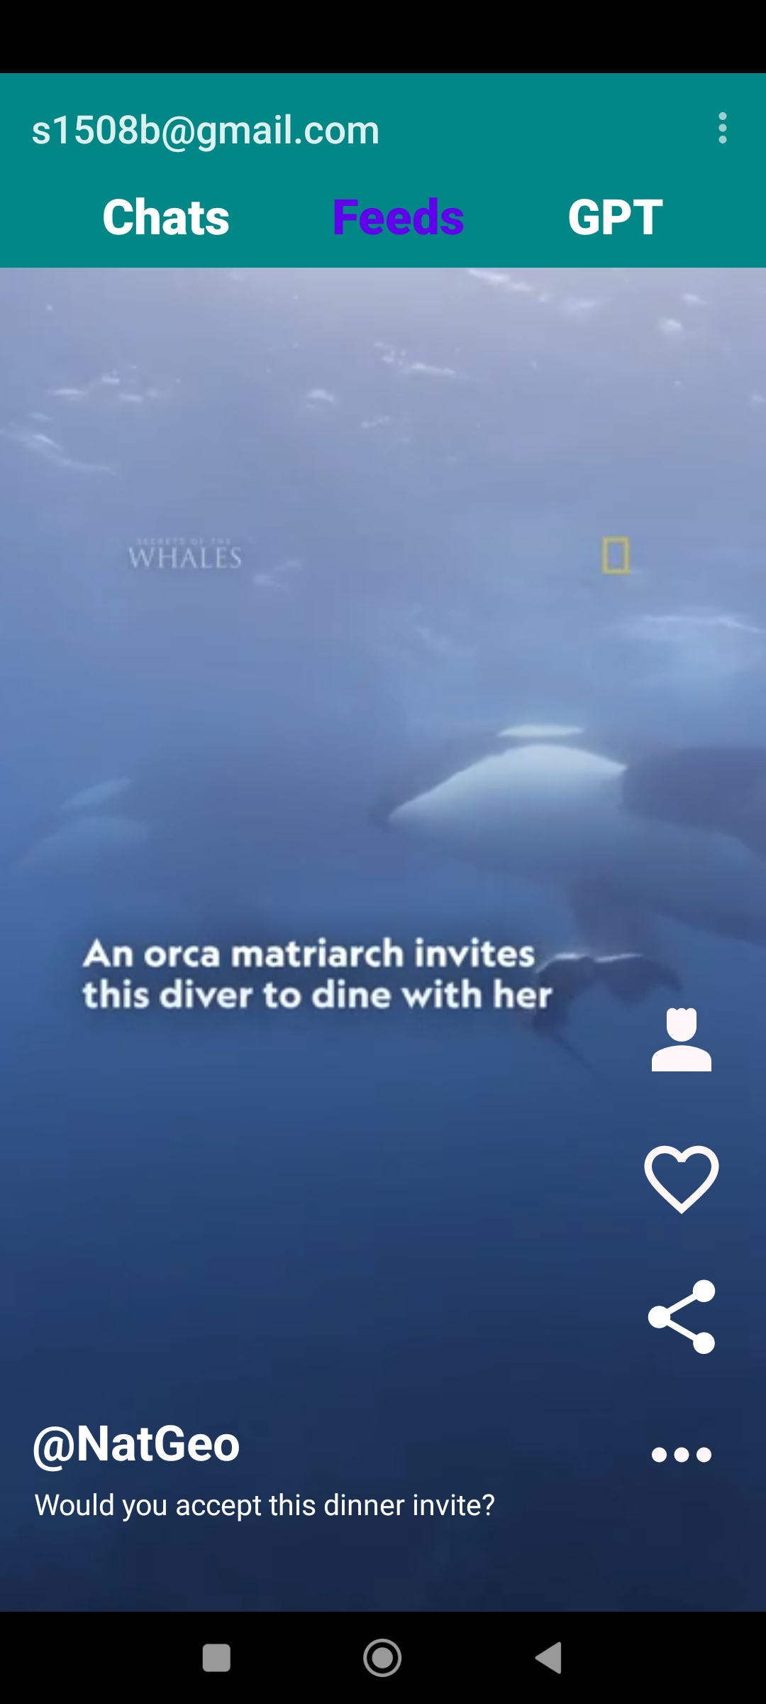
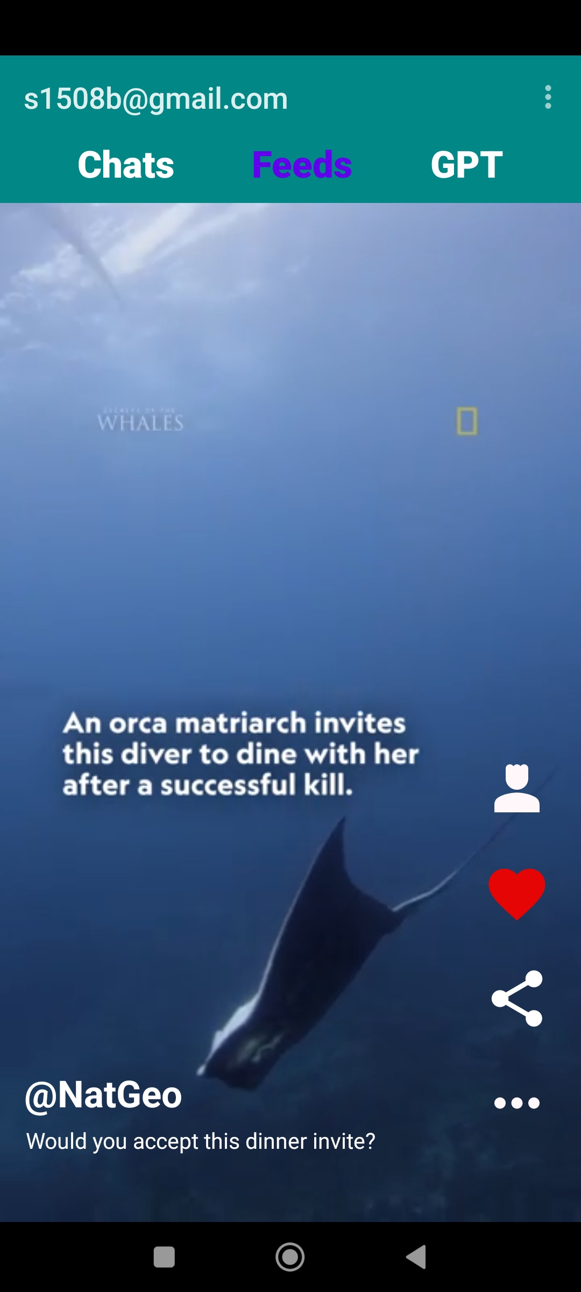
Short Videos
Scrollable short videos with like and share Option and resource optimization with recycle View.

Slide 14
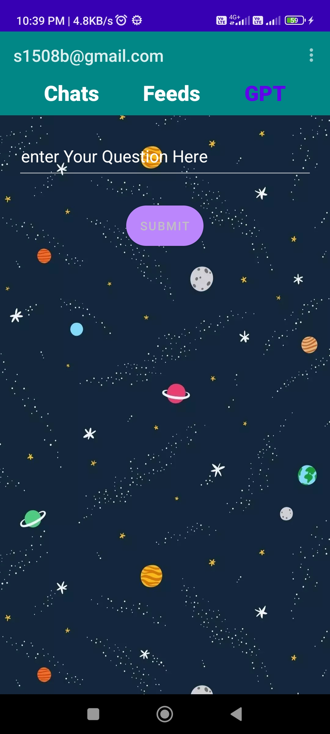
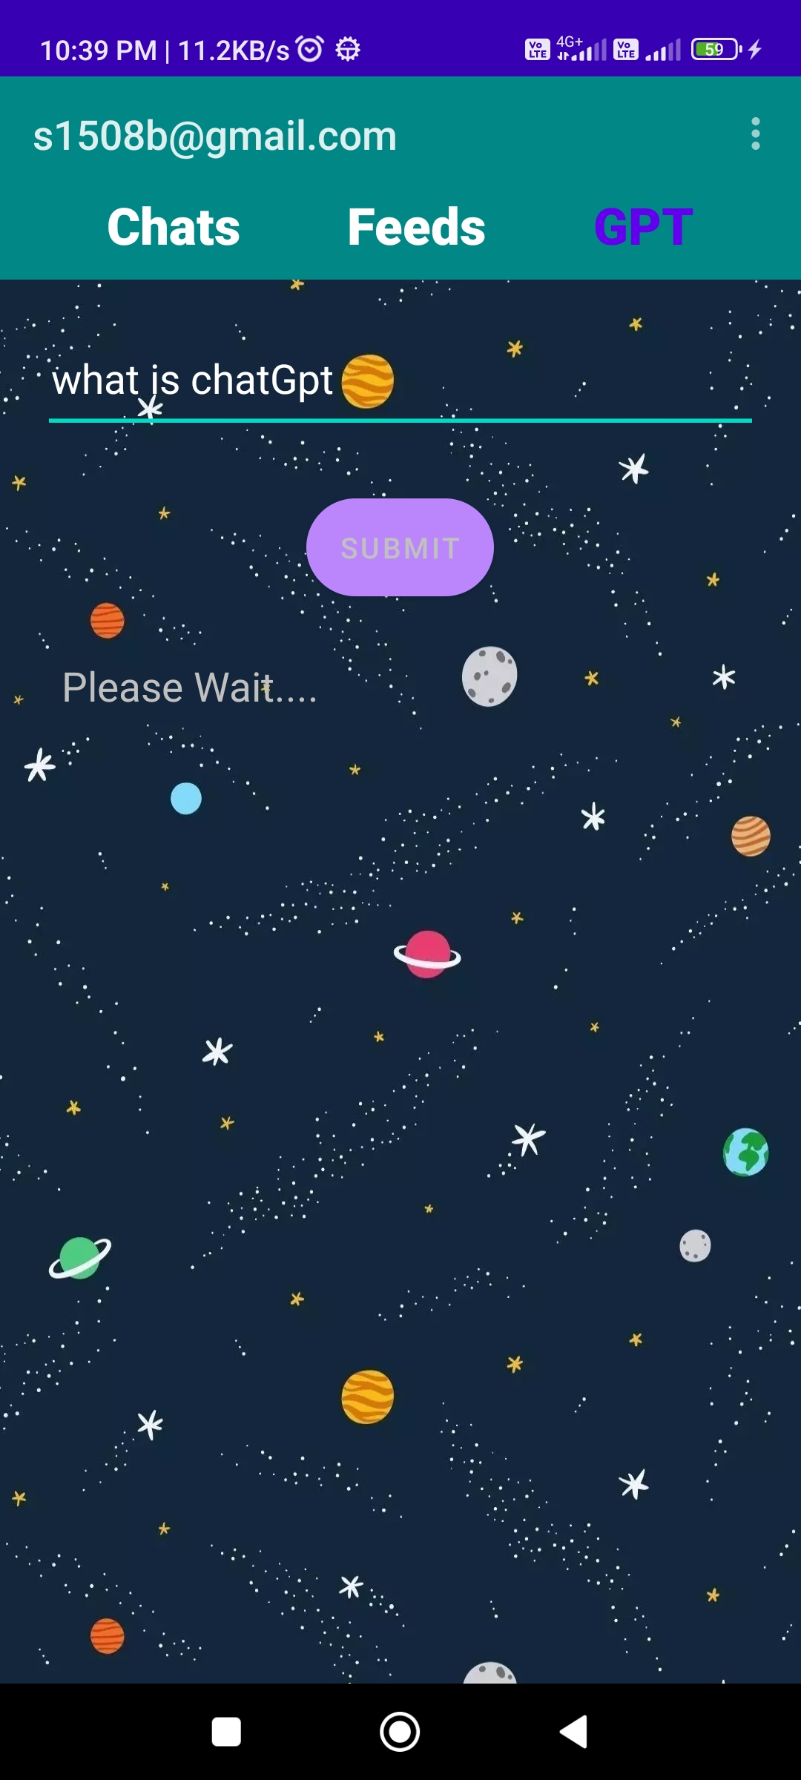
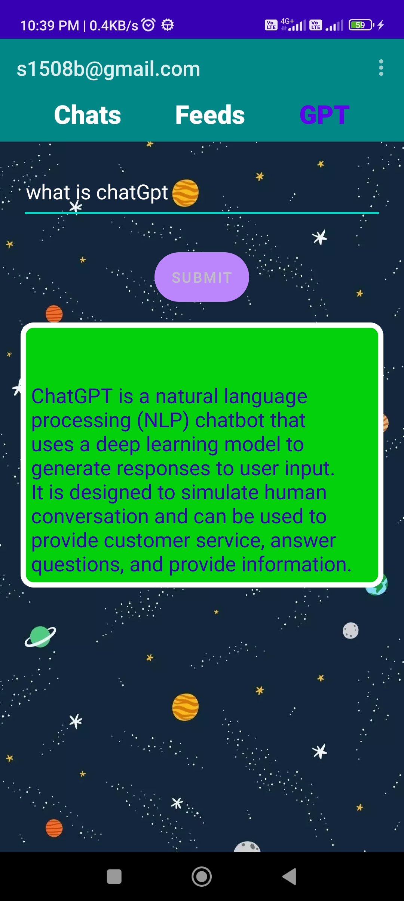
ChatGPT

Slide 15
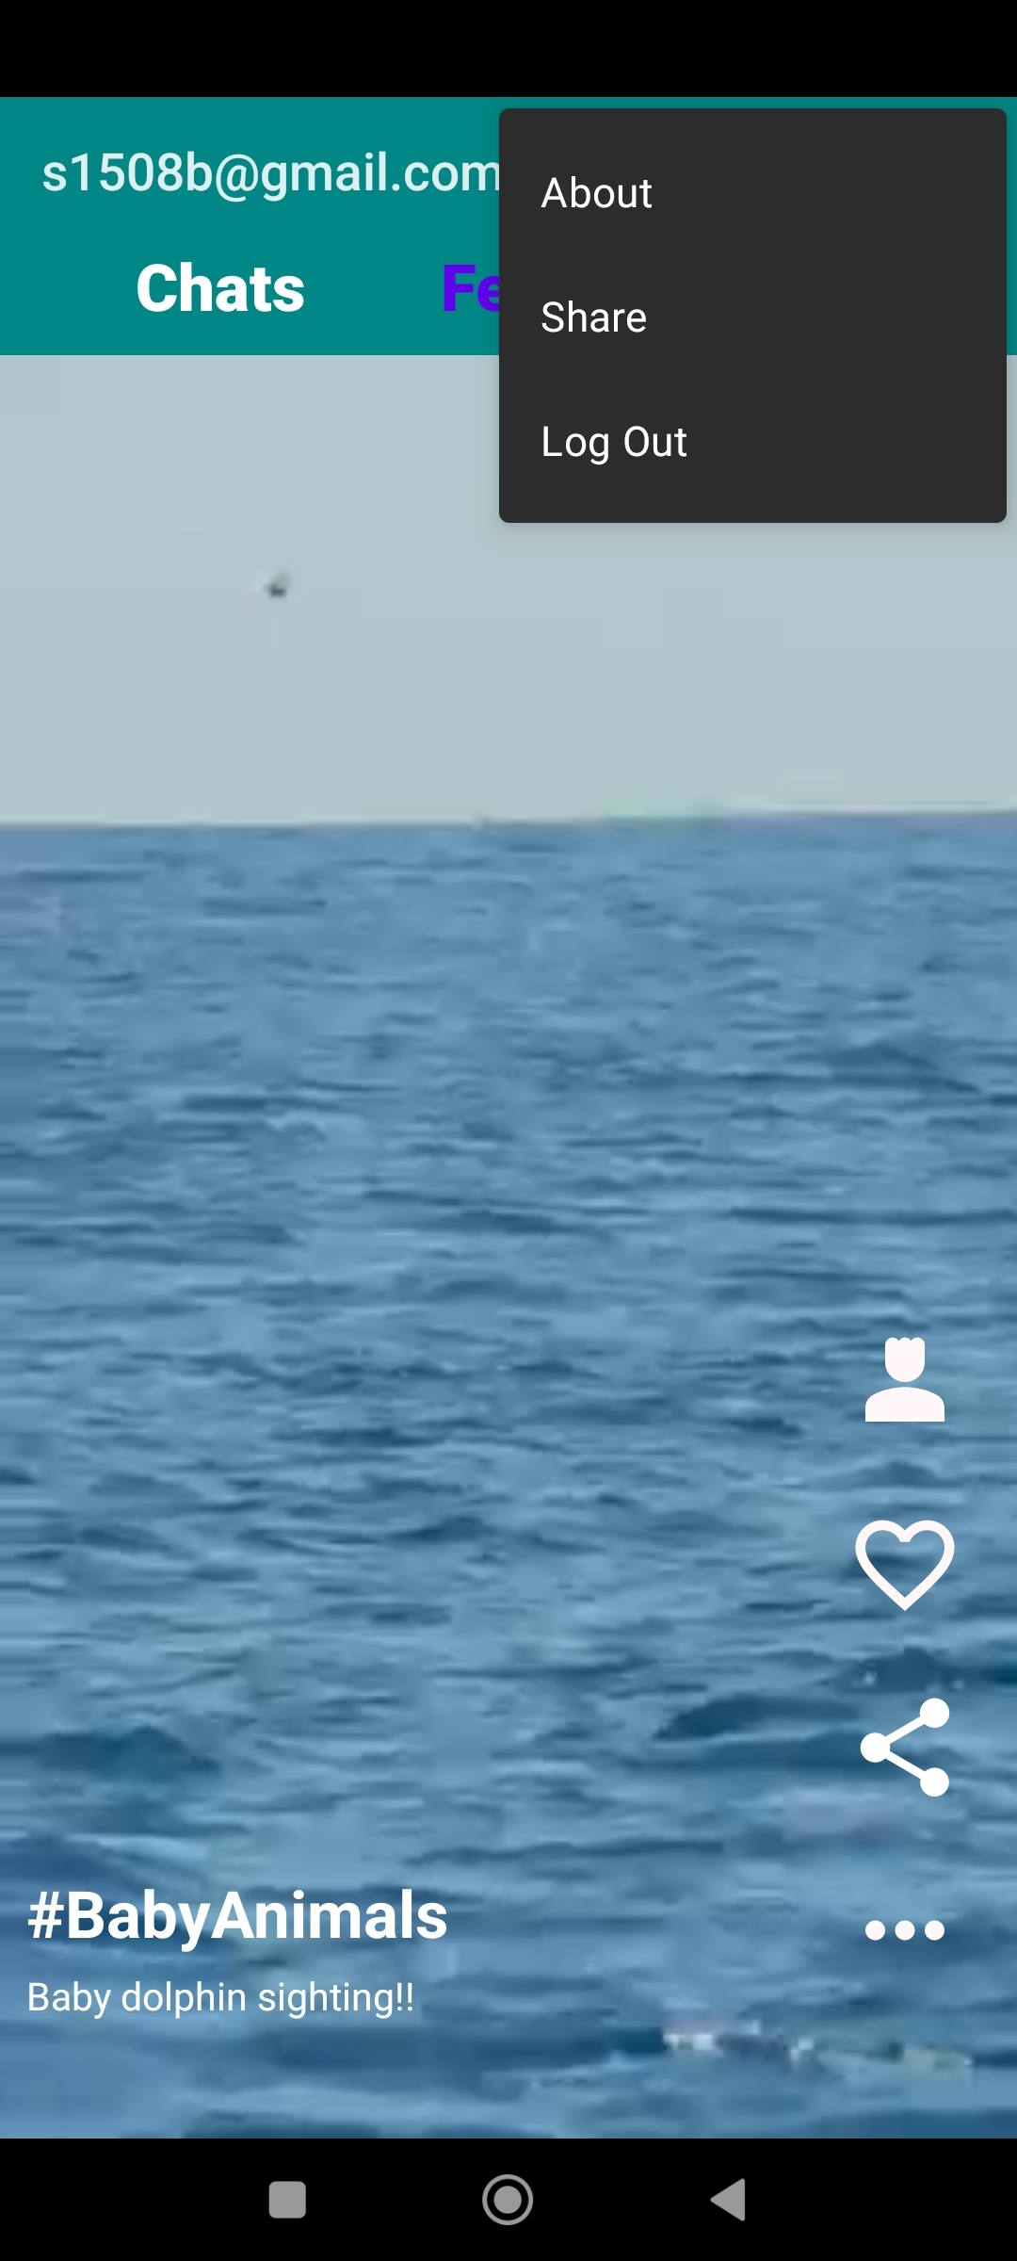
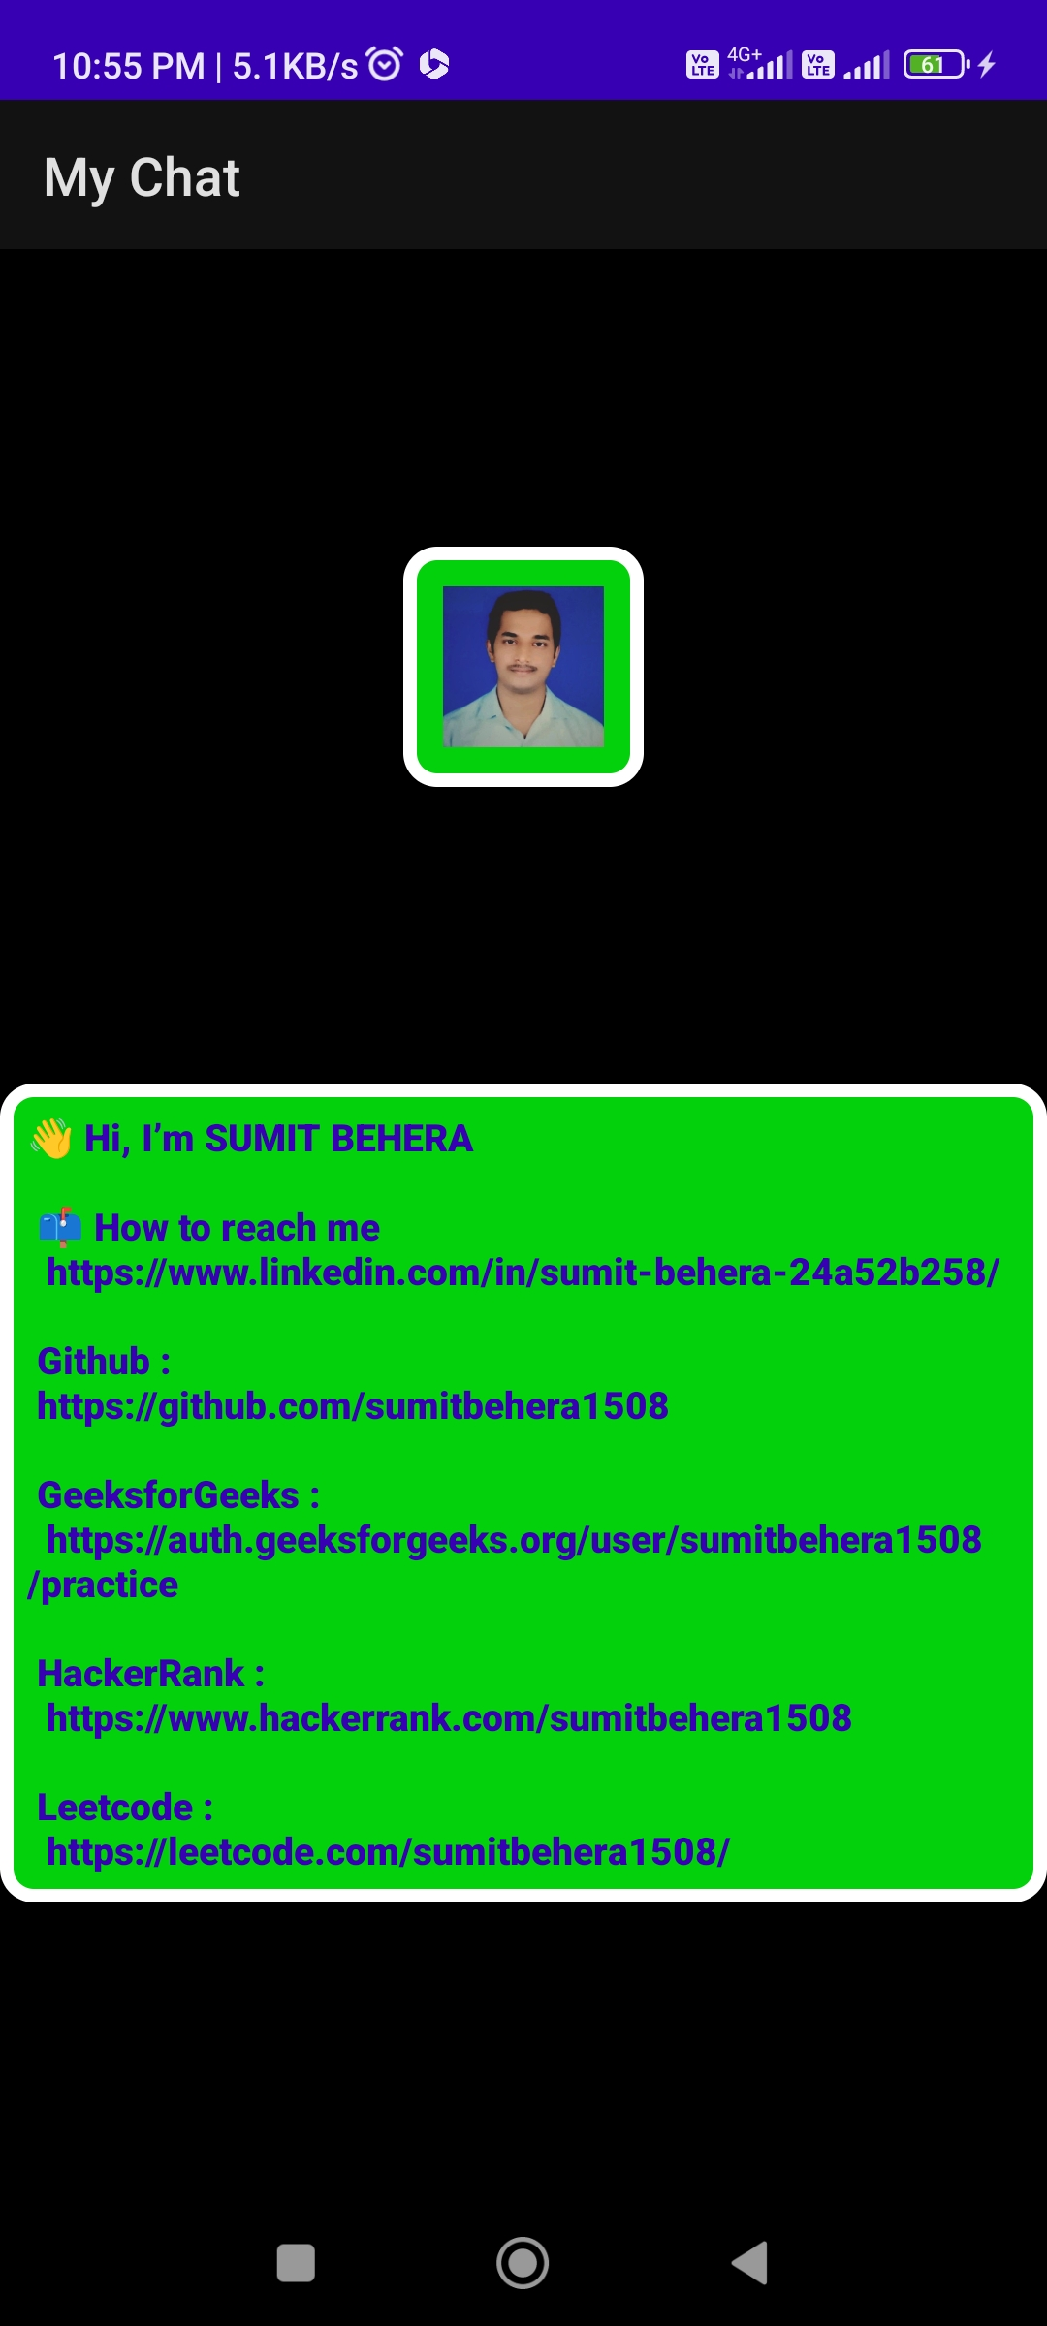
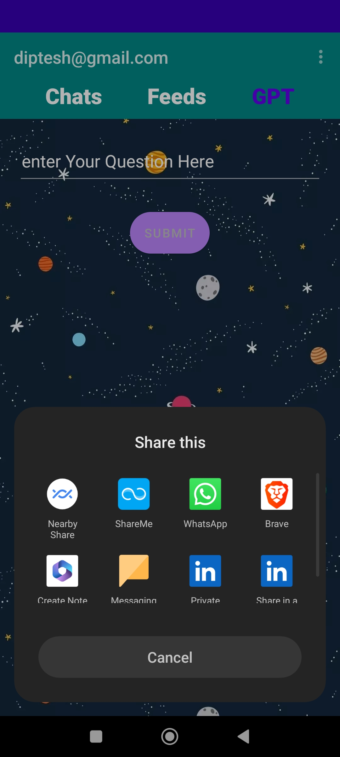
OTHER ACTIVITIES

Slide 16
10
CONCLUSION
In conclusion, the integration of short videos and ChatGPT into a chatting app opens up exciting possibilities for enhanced communication and user engagement. By combining these features, the app can offer a dynamic and immersive experience for users to connect, express themselves, and engage in meaningful conversations.
The inclusion of short videos allows users to share their creativity, talents, and ideas in a concise and visually captivating format. Users can leverage video creation tools, effects, and filters to produce compelling content directly within the app. These short videos add a new dimension to communication, enabling users to convey emotions, experiences, and stories in a more engaging and expressive manner.
With the integration of ChatGPT, the app gains the ability to generate intelligent and context-aware responses, enhancing the conversational experience. ChatGPT's advanced natural language processing capabilities enable it to understand and respond to a wide range of topics, providing users with informative, engaging, and lifelike interactions. This feature elevates the quality of conversations and fosters a more interactive and immersive chat experience.

Slide 17
—
THANK YOU

